Slide 1


CARE CONNECT
Team Members: Madhu(2310992056)
Diksha Vadehra(2310992592)
Faculty Coordinator: Vikas Patel
Chitkara University Institute of Engineering and Technology,
Chitkara University, Punjab

Slide 2
Table of Contents
Introduction
Problem Statement
Technical Details
Key Features
Project Highlights
Conclusion

Slide 3
Introduction
CareConnect Hospital is a state-of-the-art healthcare facility dedicated to delivering comprehensive and compassionate medical care. Our digital platform simplifies the patient experience by offering tools for appointment scheduling, medical record management, billing, and communication with healthcare providers

Slide 4
Purpose of the Registration Form
Why We Created This Form?
Identification: Captures user identity through name and age.
Communication: Ensures reliable contact via phone number and email.
Security: Facilitates secure user authentication and data management.?

Slide 5
Technology Stack
Frontend Development:
HTML5
CSS
Bootstrap
Interactive Elements:
JavaScript
Backend Development:
Node.js

Slide 6
Key Features
Registration Form Highlights:
Information fields include:
Username and password
Names of engaged individuals
Email and phone number
Age

Slide 7
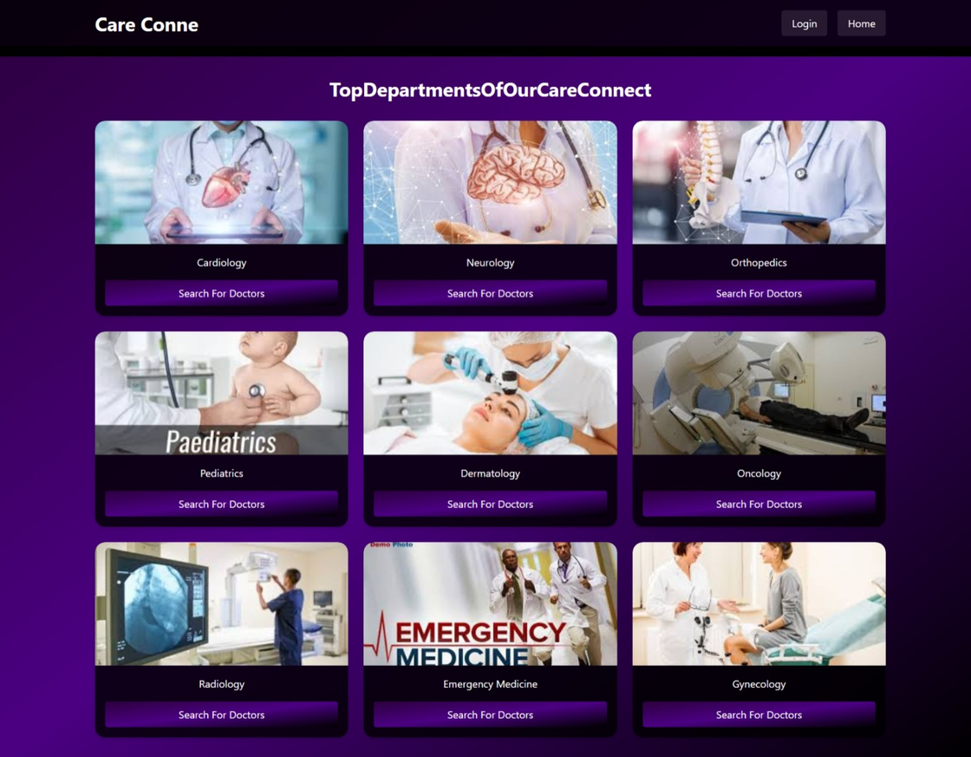
Project Highlights

Slide 8
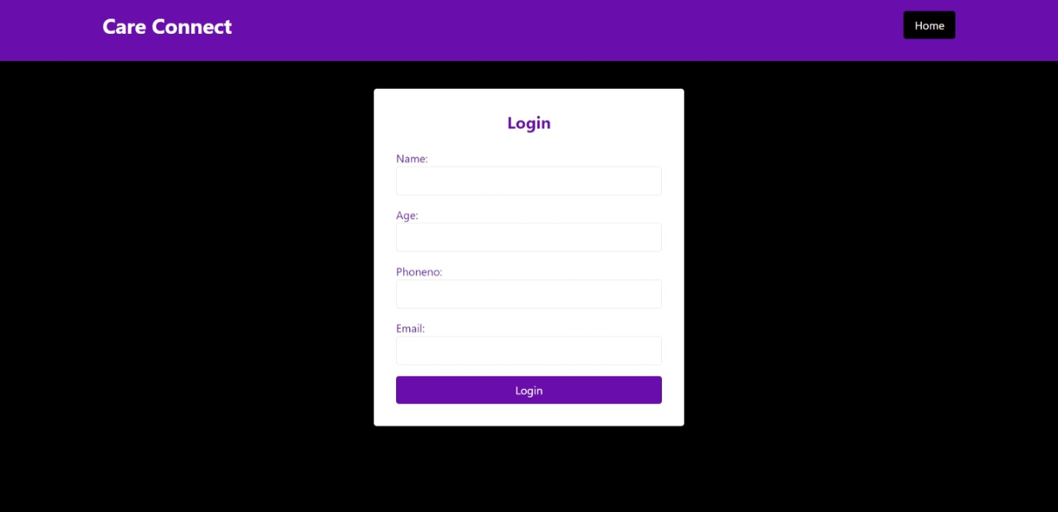
Project Highlights

Slide 9
Conclusion
The Care Connect Hospital website serves as a comprehensive digital platform to enhance patient care by providing seamless access to vital services such as registration, appointment management, and department information. With an intuitive interface, secure data handling, and personalized user experiences, it ensures convenience, trust, and efficient healthcare delivery for all users.

Slide 10



